Slide 1



Slide 2
AGENDA
Money Market - What
Capital Market- what, importance, role
Primary Vs Secondary market
Debt vs equity
Bonds - Corporate Bonds, G Secs, T- Bills
Debentures – PCD, FCD, OFCD
Shares, Stocks, Derivatives, Mutual Funds, Hedge Funds, PNs, REITS, INVITS
Venture Capitalist, Angel Investor
Foreign Capital- ECB, ADR, GDR, FCCB
FPI- FDI , FDI in Retail, FII – issues
Financial Sector regulation – current, issues & proposals – FSDC, FSLRC
Sebi- BSE, NSE, Sahara Scam
Commodities market, Forex market
CIS, Chit Funds, Ponzi schemes

Slide 3
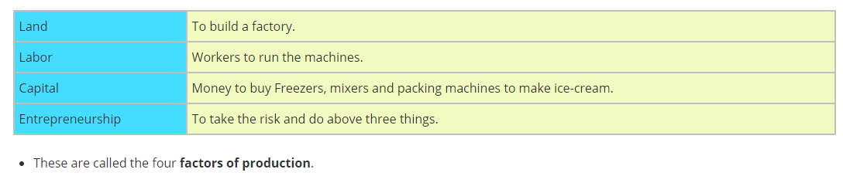
WANT TO START A BUSINESS………………
Needs Money --new business/ expanding business– Robbery, Ransom, being politician……………….

Slide 4
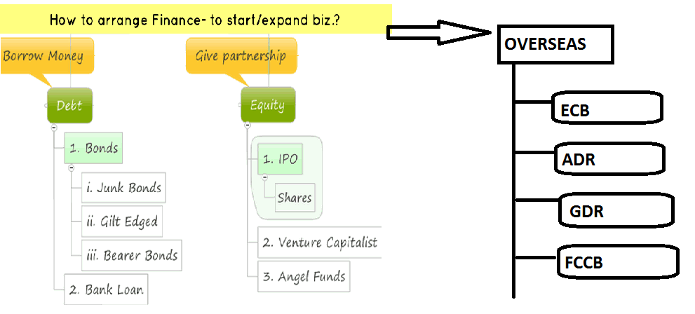


Slide 5
MONEY MARKET……..
Money market is a place where banks deal in short term loans in the form of commercial bills and treasury bills.
In money market maturity date of repayment may after one hour to 1 Year.
Rate of interest in money market is controlled by RBI .
Bankers & FIs are the main players in money market.
Mechanism – to balance short term demands & supply of funds.
Banks – to manage reserve requirements… SLR/CRR
Banks & FI s – lend on short term basis– to earn interest on idle lying cash.

Slide 6
MONEY MARKET……..
Treasury Bills- T-Bills
Govt ( RBI ) issue bonds to raise money – to meet short term financial req.
Certificate of deposits
By banks & FI s – safe instrument – at discounted price to face value.
Inter corporate Deposit
Short term loan by one FI to another
Commercial Paper
Unsecured promissory notes, requires credit rating

Slide 7
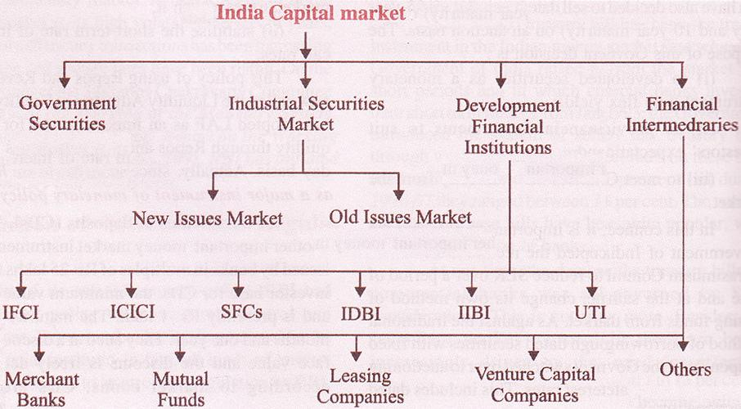
Capital Markets…………

Slide 8
Capital market
Capital market is a place where brokers deal in long term debt and equity capital in the form of debenture, shares and public deposits.
In capital market, loans are given for 5 to 20 years and if issue of shares by co., its amount will repay at winding of company. But investors have right to sell it to other investors if they need the money.
Capital market’s interest and dividend rate depends on demand and supply of securities and stock market’s Sensex conditions. Stock market regulator is in the hand of SEBI.
Main dealers are all the public and private ltd. Co.
It is increasing trend due to opening of online capital market.
PRIMARY MARKET AND SECONDARY MARKET
Primary Market: In the primary market, securities are offered to public for subscription for the purpose of raising capital or fund. (IPO, FPO)
Secondary Market: Secondary market is an equity trading avenue in which already existing/pre- issued securities are traded amongst investors.

Slide 9
Why Capital Market Exist:
Capital Market facilitate the transfer of capital (e.g. finance) assets from one owner to another.
They provide Liquidity: Liquidity refers to how easily an asset can be transferred without loss of value.
Role of Capital Markets:
Mobilization of savings & acceleration of Capital Formation
Promotion of Economic Growth and Development
Proper Regulation of Funds
Investment Avenue
Raising of Long Term Capital
Incentives & deterrent for organization- activities
Attracting foreign capital for domestic /industrial development
Saving poor’s money – from ponzi schemes, fraud chit funds etc….

Slide 10
Some Definitions:-
'securities' include:
(i) shares, stocks, bonds, debentures, debenture stock or other marketable securities of a like nature
(ii) derivative,
(iii) units or any other instrument issued by any collective investment scheme to the investors in such schemes,
(iv) Government securities,
(v) such other instruments as may be declared

Slide 11
CAPITAL MARKETS…… DEBT VS EQUITY
What is a Debt Market?
The Debt Market is the market where fixed income securities of various types and features are issued and traded.
Debt Markets are therefore, markets for fixed income securities issued by Central and State Governments, Municipal Corporations, Govt. bodies and commercial entities like Financial Institutions, Banks, Public Sector Units, Public Ltd. Companies.
CORPORATE BONDS – regulated by SEBI
issued by private and public corporations
to raise money for a variety of purposes, such as building a new plant, purchasing equipment, or growing the business
one lends money to the "issuer," the company that issued the bond.
the company promises to return the money, also known as "principal," on a specified maturity date - usually pays you a stated rate of interest.
if one sells a bond before maturity, it may be worth more or less than it was paid for
No ownership……

Slide 12
Capital Market……
There are potential risks associated with this market, such as, absence of robust bankruptcy framework, insufficient liquidity, narrow investor base, refinancing risk, lack of better market facilities and standardisation.
Banks NPA, 2008 global crisis, Infrastructure financing - need a robust corporate bond market for diversifying risk.
India has a very advanced G-sec market; its corporate bond market is relatively under developed
gilt-edged securities’ vs Junk Bonds - CRA
G-sec market – Regulated by RBI
Govt raise funds by issuing bonds – public, company, banks, FI s
Banks – safe investment, mandatory SLR
Have low interest rate – considered safe investment
Foreign investors – can also invest – SEBI & RBI – Sovereign rating
T- bills (< I yr), T- notes ( 1-10 yr), T-bonds ( > 10 yr)

Slide 13
DEBENTURE
A type of debt instrument that is not secured by physical assets or collateral.
Debentures are backed only by the general creditworthiness and reputation of the issuer.
Debentures have no collateral.
Bond buyers generally purchase debentures based on the belief that the bond issuer is unlikely to default on the repayment
Convertible Debentures
These are the debentures that can be converted into shares of the company on the expiry ofpre-decided period
Non-convertible Debentures
The holders of such debentures can not convert their debentures into the shares of the company.
Partially Convertible debentures
Optionally fully-convertible debentures (OFCD)?- Sahara Scam…
These debentures can be converted into shares, when debt holder (investor) wishes (after expiry of xyz pre-decided date).
But the “rate”, will be decided by the company e.g. 20 debentures =>1 share.
From investor’s view, this “option” to convert Debenture into Shares is good ONLY IF
Company is likely to make huge profit (so you, the shareholder can EARN MORE dividend.)

Slide 14
Capital Markets – Equity Market
Take money from someone and offer him part ownership of the company.
Shares/Stocks, Angel Investors, VC
Shares vs stocks
“50 Shares” of this company and Rs 10/each share
“stock of Rs.500” in this company.
Issuing Shares:- IPO, FPO,
Rights issue:- issue additional shares to the existing shareholders only
Dividends
Bonus shares:- company also gives you extra shares instead of paying dividend

Slide 15
Venture Capital is a company that gives you money, to start your company or to expand your company but in return they demand part of ownership.
They deal with only ‘big’ things, ‘big’ projects, ‘big’ investments
They’ve their own team of Management experts, corporate lawyers, chartered accountant, and business consultants. They study your business plan, approve the money.
Hands on approach- decision making
They pool money from other resources.
Generally – later stages
Angel Investors:- Invests own money
May be willing to be "hands-off" or "hands-on“
Generally- initial stages
they demand part of ownership
Both VC & AE- sell their shares when co. listed & co. itself gives them money in return of ownership they hold.

Slide 16
Mutual Funds
An investment vehicle that is made up of a pool of funds collected from many investors for the purpose of investing in securities such as stocks, bonds, money market instruments and similar assets.
Mutual funds are operated by money managers, who invest the fund's capital and attempt to produce capital gains and income for the fund's investors.
A mutual fund's portfolio is structured and maintained to match the investment objectives stated in its prospectus.
One of the main advantages of mutual funds is that they give small investors access to professionally managed, diversified portfolios of equities, bonds and other securities
Open Ended Mutual Fund
Close Ended Mutual Funds

Slide 17
Hedge Funds & PNs
Hedge funds
as private investment partnerships that are open to a limited number of investors and require a very large initial minimum investment.
Long term, high initial requirement, cater to sophisticated investors, conditions
Very big, very risky – high risk high return principle
Banned in India
Participatory Notes
Participatory notes are offshore derivative instruments issued by FII
These instruments aid investors who do not want to register with SEBI and reveal their identities to take positions in the Indian market.
Earlier making 40% of FII,
2007 SEBI – strict regulation – crticised
Now Some norms relaxed- 10-15% of FII

Slide 18
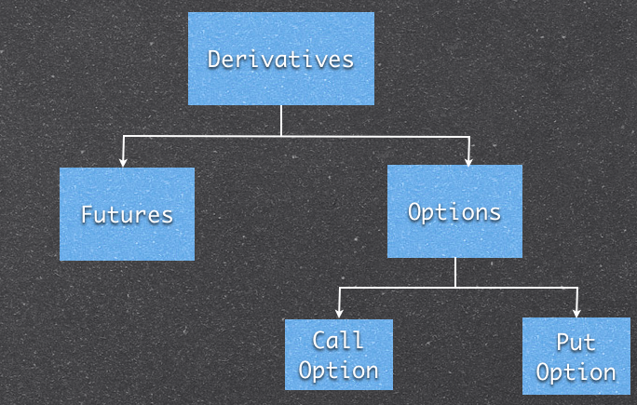
Derivatives
A derivative is a financial instrument whose value is based on one or more underlying assets.
ECB- External Commercial Borrowing- raising resources from foreign resources- bans, FIs – regulated by RBI- control on limits & purpose
A foreign currency convertible bond (FCCB) is a type of corporate bond issued by an Indian listed company in an overseas market and hence, in a currency different from that of the issuer.
the option of converting the bonds into equity at a price determined at the time the bond is issued.
It also has the benefits of a debt instrument as it includes guaranteed returns or yields which are payable in foreign currency.

Slide 19
Raising money from foreign resources-
ECB , FCCB, ADR, GDR,
Both ADR and GDR are depository receipts, and represent a claim on the underlying shares. The only difference is the location where they are traded.
If the depository receipt is traded in the United States of America (USA), it is called an American Depository Receipt, or an ADR.
Suppose, Indian Co. wants TO RAISE MONEY from America, by issuing shares in American stock exchange.
But then Indian co. will have to maintain accounts according to American standards.
To prevent this problem, Indian company gives its shares to American bank.
American bank gives that Indian company receipts (called ADR) in return of those shares. Then Indian Co. can trade those ADR receipts in American share market, TO RAISE MONEY
Sound good? Yes, but then Indian company will have to pay dividends to those investors in Dollar currency.
If the depository receipt is traded in a country other than USA, it is called a Global Depository Receipt, or a GDR.

Slide 20
IDR
ADR= American depository receipt = from America’s point of view, it allows a foreign company (e.g. Indian) TO RAISE MONEY from American financial market.
Similarly, IDR= Indian depository receipt= from India’s point of view, it allows a foreign company (e.g. American, British) TO RAISE MONEY from Indian financial market.
STAN C- only 1 till date
unfavourable regulations, including absence of two-way fungibility
IDR two-way fungibility -2013
IDRs can be converted into underlying equity shares, and the underlying shares can be converted into IDRs

Slide 21
FPI- FDI, FII, QFI
FII
FDI
when a foreign company invests in India directly by setting up a wholly owned subsidiary or getting into a joint venture
Stable
Capital Formation
Technology & management – know how
Employment
Catering domestic needs
Increase healthy competition
Tax revenues
Hurt domestic industry
Tax revenues – not – take adv of loopholes
Difficult to attract & difficult to leave
when foreign investors invest in the shares of a company that is listed in India, or in bonds offered by an Indian company
Hot Money – come & leave - quickly
Quick to attract- response to economy indicators
Cause volatility to market
No technology, no jobs, no capital formation
Very sensitive to global economic factors

Slide 22
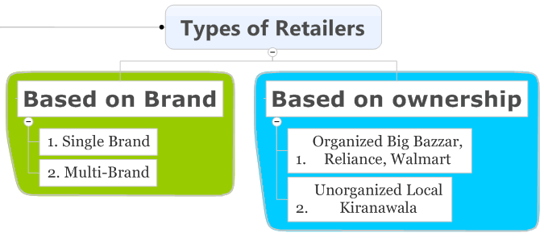
FDI in Multi Brand Retail---
Govt allowed Multibrand reatail- 51% - conditions
Million Plus cities, Min of $100 mn, 50% in backend infra,
Min. compulsory procurement from MSME

Slide 23
FDI in Multi Brand Retail-
Pros
Cons
Backend infra- less wastage, taming inflation
Technology & management knowhow- SCM
Better price to farmers- scientific knowhow – direct selling – no middle man
More taxes to govt, revenues- $ 30 bn
More choice, saving to customers
Good quality – no fake products
Hurting local kiryana stores- employment
Hurting local manufacturers
Predatory pricing – expensive to customer- in long run
Exploitation of innocent farmers
Fears Exaggerated , safeguards
Gradual expansion – in million cities only, already have multibrand stores-
both surviving- complement each other
Employment – disguised employment
Predatory pricing- CCI

Slide 24
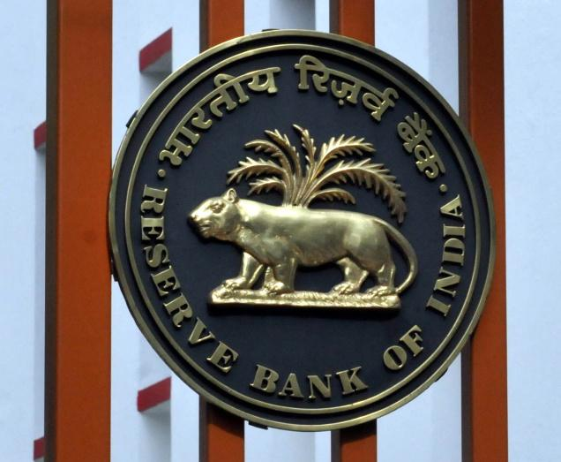





Slide 25
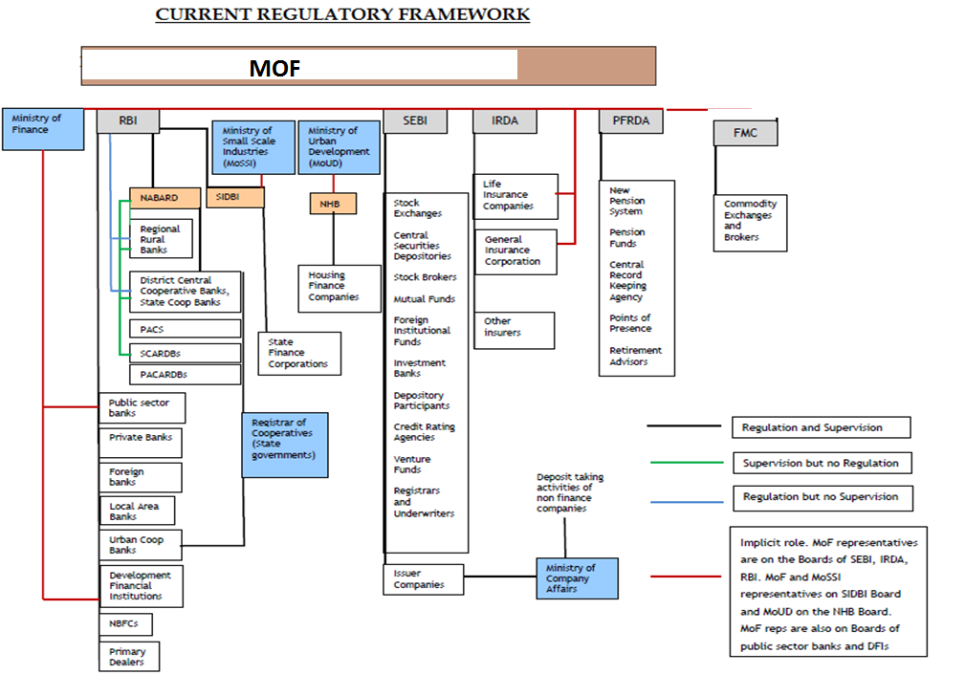

Slide 26
SEBI
SEBI act 1992- initially non statutory body
1998 the SEBI was constituted as the regulator of capital markets in India under a resolution by GOI.
SEBI has to be responsive to the needs of three groups, which constitute the market:
the issuers of securities
the investors
the market intermediaries
SEBI- quasi legislative, quasi executive, quasi judicial
SEBI Initiates:-
Corporatization and Demutualization of Stock Exchange
Dematerialization of shares, e- trading
T+2 settlement- to avoid speculation
Rolling settlement – no grouping
Mutual Fund –Industry
SCORES- SEBI Complaints Redress System

Slide 27
Stock exchanges:-
BSE- Sensex
NSE- Nifty
Asia oldest- 1875
Sensex is a basket of 30 constituent stocks representing a sample of large, liquid and representative companies
The base year of Sensex is 1978-79 and the base value is 100
5500 companies – largest
Market Cap - $ 1.7 trn – 11th
1992
Nifty- 50 cos
The base year is taken as 1995
The base value is set to 1000
1700 cos
Market Cap - $ 1.65 trn – 12th
^{Less volatile}

Slide 28
Other Exchanges--
Currency trading- earning money- variation in exchange rate
MCX Stock Exchange Limited (MCX-SX)
India’s new stock exchange, commenced operations in the Currency Derivatives (CD) segment on October 7, 2008
under (SEBI) and Reserve Bank of India (RBI).
Commodities Trading:- same as shares market- but commodities traded
Regulated By FMC
Multi Commodity Exchange of India Ltd (MCX)
electronic commodity futures exchange.
2003, today, MCX holds a market share of over 85%* of the Indian commodity futures market.
MCX offers more than 40 commodities

Slide 29
Low Investor Base – Stock Market
1.5 crore investors only
Difficult to understand
Lack of awareness – Financial Literacy drives
Attraction towards Gold –ETF, Gold Deposit scheme
Mentality – Low risk
Digital divide
ETF – hybrid product
Mutual fund = Investors <–>Mutual fund manager (AMC) <–>sharemarket
AMC<–>authorized participants <–> Share-market <—>Investor
ETFs are then sold to small investors and traded @stock exchange.
Pros – Gold in demat form, quick buy & sell, money for capital formation
Cons- unfamiliarity with stock trading platform, attraction for physical gold

Slide 30
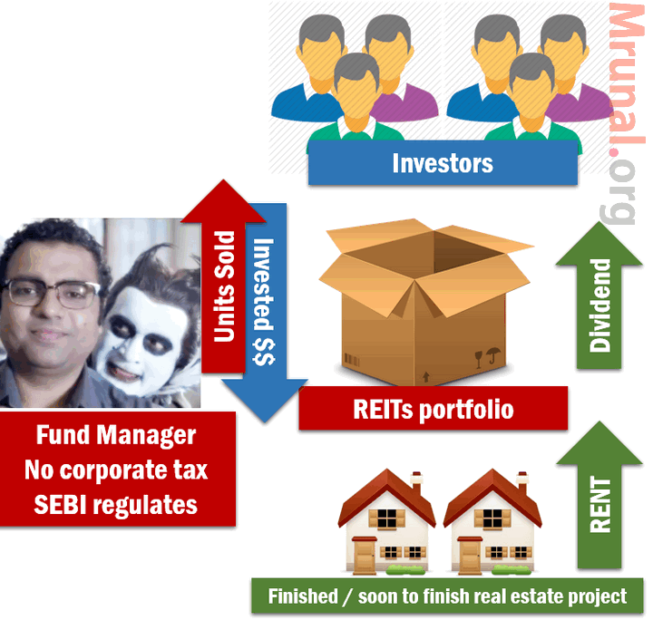
REITS & InvITS
Real Estate Investment Trusts (REITS)
InvITS :- Infrastructure investment trusts
Mechanism similar to REITS.
fund manager builds infrastructure- ports, powerlines, highways.

Slide 31
SEBI- SAHARA issue…..
Two firms of Sahara Conglomerate:
Sahara Housing Investment Corporation
Sahara India Real Estate Corporation. (aka Sahara Commodities)
These ^two companies Issued OFCD to collect money from investors.
~23 million people, mostly from villages and small towns subscribed to this scheme.
They invested ~24,000 crores rupees in these OFCDs of SAHARA.

Slide 32
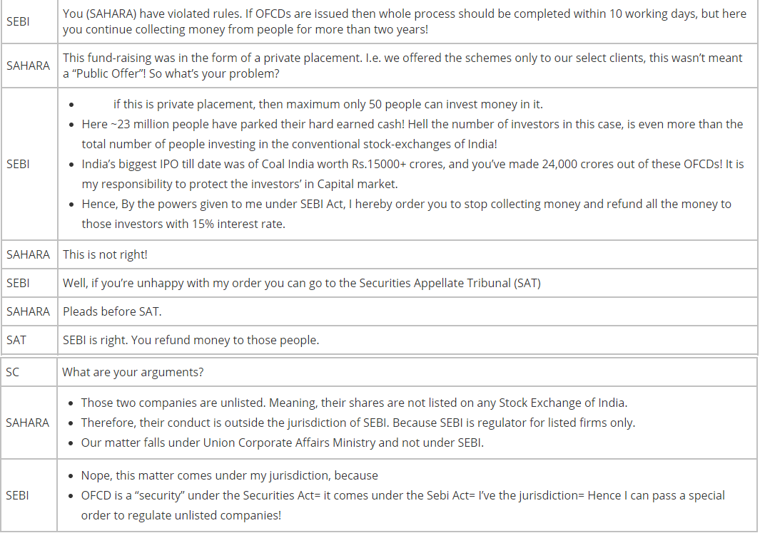

Slide 33
Problems faced in the existing framework
Complexity
Plethora of Acts
Conflicts of Interest
Regulatory Overlaps leading to Conflicts(PFRDA Vs IRDA ;SEBI Vs IRDA)
Regulatory gaps (chit funds & Ponzi schemes)
Problems of Co-ordination
Initiatives Taken – FSDC & FSLRC
Notes:
complexity – both in terms of the sheer number of regulatory, quasi-regulatory, non-regulatory-but-still-regulating bodies, and also because of their overlapping, ambiguously defined respective spheres of concern and influence.
Acts originated when financial landscape was very different from today’s times
This time it is PFRDA Vs. IRDAfor regulation of pension products offered by insurance companies.
SEBI Vs IRDA for ULIPs by Insurance Co.s
UFA( SEBI , FMC, IRDA ,PFRDA)
the regulatory arbitrage emerging from it, because there are spaces in the financial system that are either regulated by multiple entities with little clarity on division of responsibilities, or are regulated by agencies that do not have the competence to regulate them effectively. An example of this is the regulation of district cooperative banks, which are supposed to be regulated by the RBI and by the registrar of cooperatives in their respective states. While the former has the expertise, it does not have the regulatory bandwidth to regulate these institutions, and the registrar of cooperatives have a more direct role in their regulation, but they typically do not have the expertise to regulate such deposit-taking entities

Slide 34
FSDC – Financial Stability & Development council
Super Regulatory body
Headed by FM
Financial Stability
Financial Sector Development
Inter-Regulatory Coordination
Financial Literacy
Financial Inclusion
Coordinating India's international interface with financial sector bodies like the Financial Action Task Force (FATF), Financial Stability Board (FSB) etc.

Slide 35
FSLRC’s Regulatory Architecture
Present | Proposed | Functions
RBI | RBI | Monetary policy; regulation and supervision of banks; regulation and supervision of payments system.
SEBI FMC IRDA PFRDA | United financial agency (UFA) | Regulation and supervision of all non-bank and payments related markets.
Securities Appellate Tribunal (SAT) | FSAT | Hear appeals against RBI, the UFA and FRA.
Deposit Insurance and Credit Guarantee Corporation (DICGC) | Resolution Corporation | Resolution work across the entire financial system.
Financial Stability Development Council (FSDC) | FSDC | Statutory agency for systemic risk and development.
New entities | Debt Management Agency | An independent debt management agency.

Slide 36
Collective Investment Scheme (CIS) Vs Chit Funds Vs Ponzi Schemes
CIS is a kind of an investment scheme in which individuals come together and pool their money for the purpose of investing in some assets and for sharing returns that are gained by such investment
To run Collective Investment scheme, you have to get permission - SEBI.
CHIT Funds :- kind of an investment scheme
Members contribute money on monthly basis, and give it to one of their own member through bidding.
Winner doesn’t need to repay “loan” directly, but needs to contribute money on monthly basis, so others can also win next time.
State government’s registrar- state govt respective acts
SEBI Act excludes chit funds from its ambit as Chit Funds are regulated by the Chit Fund Act of 1982.
RBI only provides overall guidelines

Slide 37
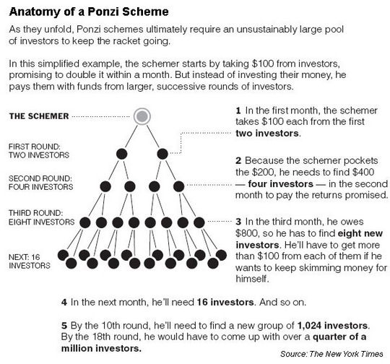
Collective Investment Scheme (CIS) Vs Chit Funds Vs Ponzi Schemes
Ponzi Schemes – MLM schemes
To handle such schemes- to regulate CIS in better- new SEBI act- any money raising above limit of Rs 100cr- CIS- under SEBI

Slide 38
Calculating Sensex
Market capitalization – Total Market Cap to free float market cap
market capitalisation weighted method in which weights are assigned according to the size of the company.
Larger the size, higher the weightage.
base year of Sensex is 1978-79 and the base index value is set to 100 for that period.
SENSEX = Total Free float market cap (FFMC) of 30 companies today divided by Total (FFMC) of 30 companies on 1st April 1979

